Slide 1
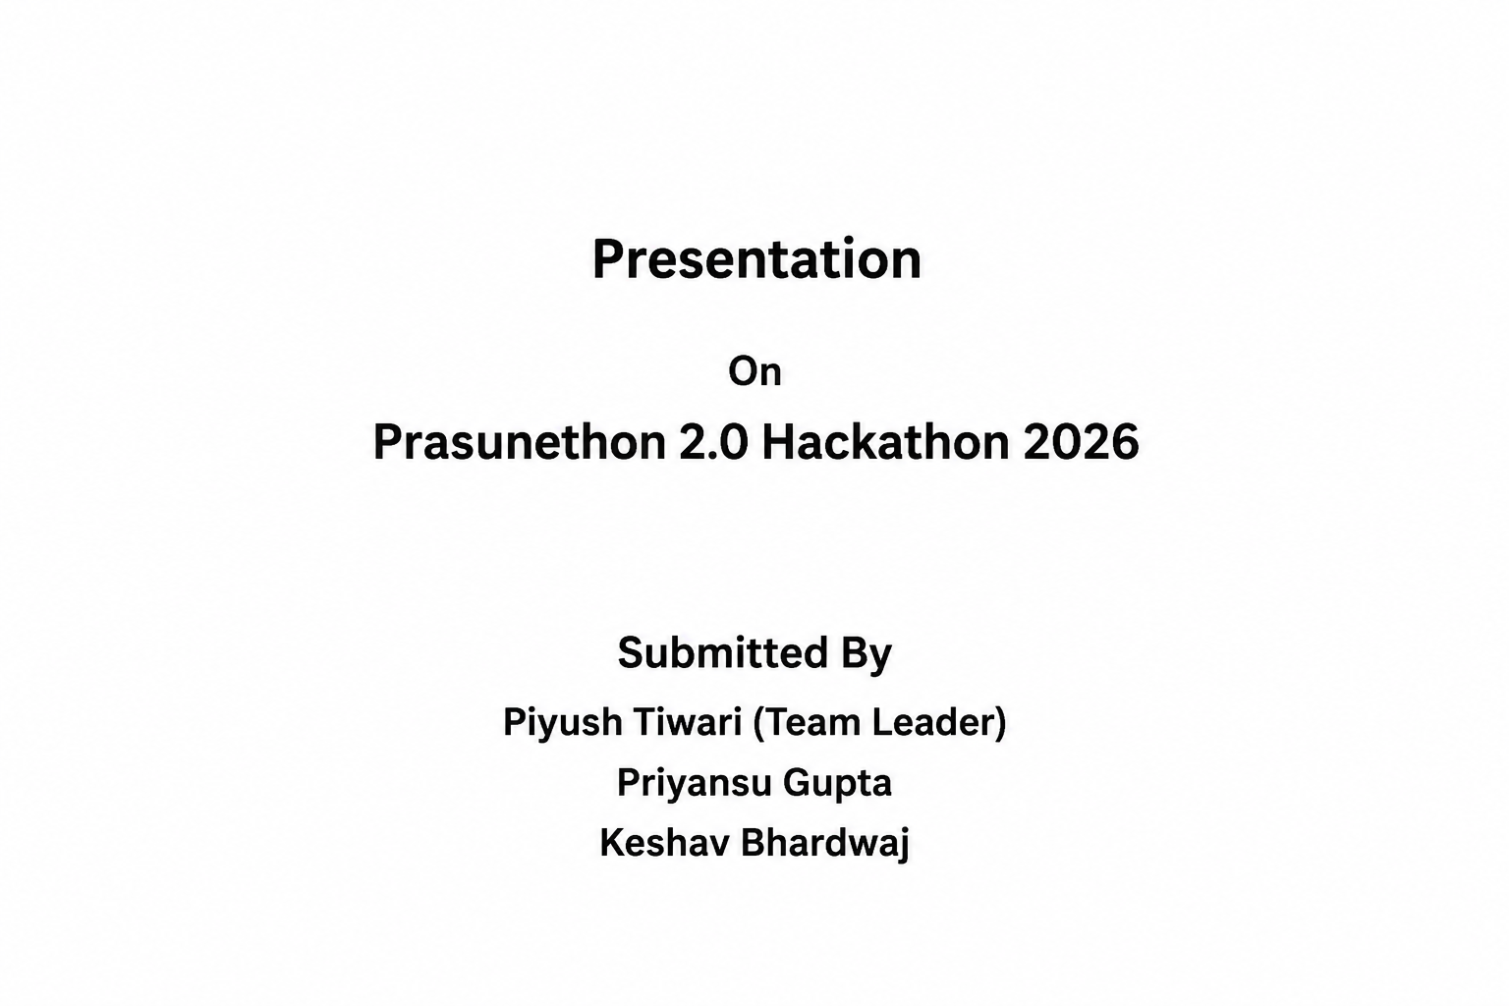
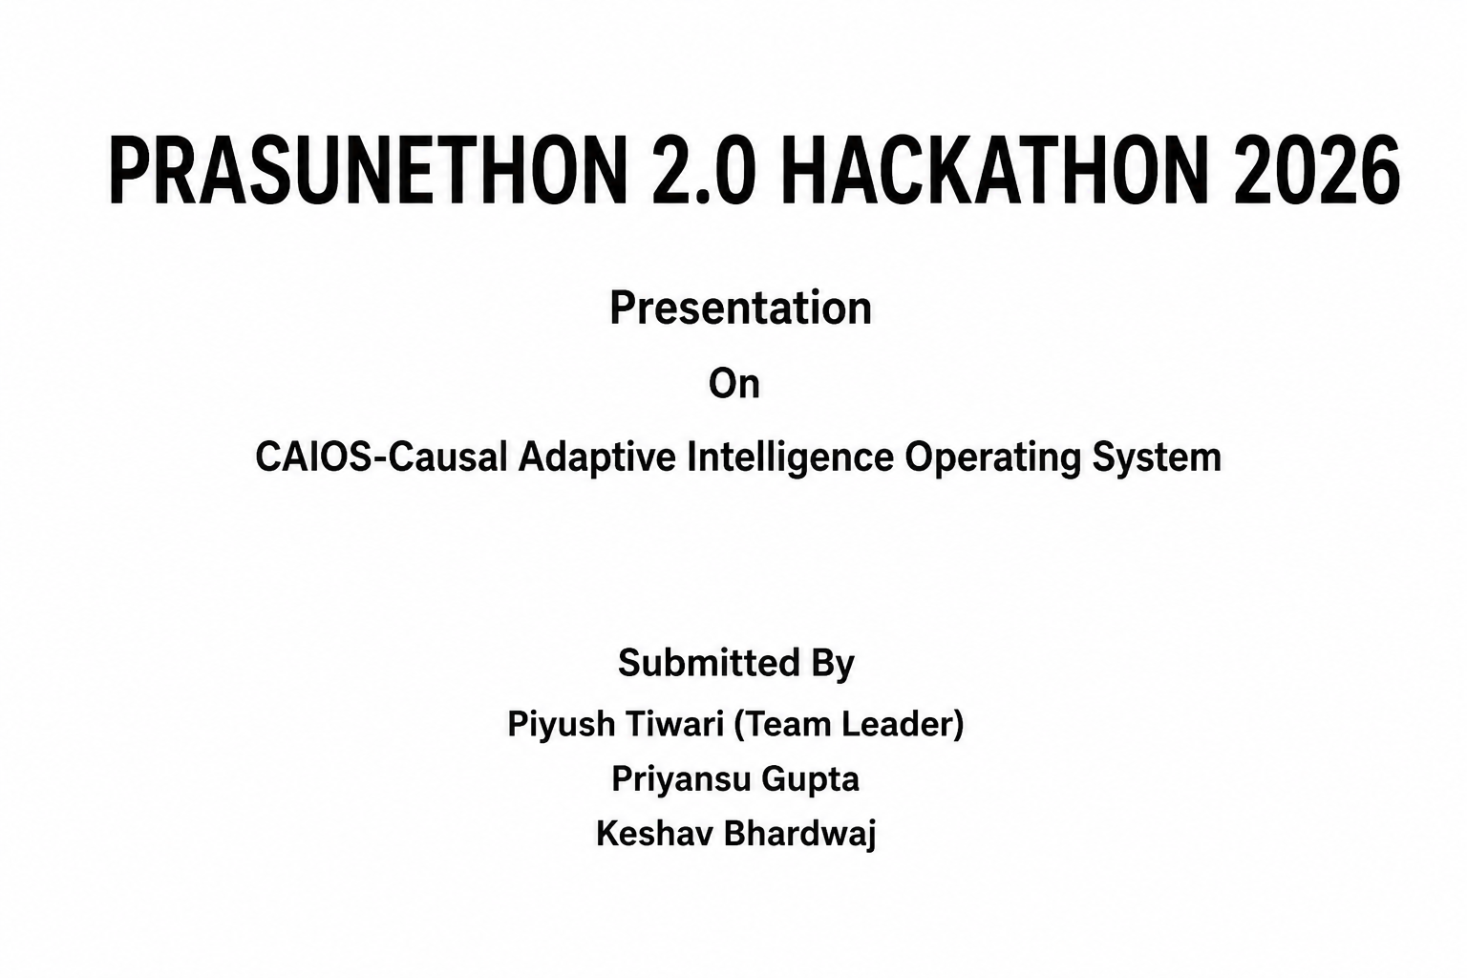
Presentation
On
CAIOS-Causal Adaptive Intelligence Operating System
Notes:
1

Slide 2
Introduction
Background :
AI systems today mostly predict outcomes through correlation, not true cause and effect making decisions hard to trust, explain, or adapt when conditions change.
Overview :
CAIOS (Causal-Adaptive Intelligence OS) is a causal-inference-driven decision layer that understands why outcomes happen and automatically adapts system behaviour in real.
Idea Summary :
An explainable, self-adapting intelligence system that bridges causal AI with adaptive computing so decisions aren't just predicted, they're understood and acted on.
Notes:
2

Slide 3
Opportunity Recognition & Feasibility
Problem Recognition:Most AI systems today make decisions using correlation instead of true cause-and-effect relationships. This makes their outputs hard to trust, explain, or justify when conditions change.
Existing Gap / User Need:Causal-AI platforms like decisionOS exist as business dashboards; no unified OS-level layer combines causal reasoning with self-adaptive computing.
Feasibility Study:Open-source causal frameworks (e.g., DoWhy) can be paired with a self-adaptive monitor analyze plan execute loop to make this feasible.
Support with Data / Observations:Market reports vary widely in size estimates, but consistently cite explainability and regulatory pressure as the core growth driver.
Notes:
3

Slide 4
Proposed Solution
CAIOS is a causal-inference-driven decision and adaptation system that analyzes cause-effect relationships in data instead of just correlations, enabling more trustworthy, explainable decisions.
It builds a causal model from the input data and uses it to identify why an outcome occurs, then reasons about which intervention would actually change that outcome not just which factors are statistically associated with it.
Value Proposition: An explainable, decision-intelligence system that goes beyond black-box prediction showing not just what will happen, but why,and what action would change it, through an interactive dashboard.
Key Features:Causal Graph Modeling, Cause-Effect Analysis, Counterfactual "What-If" Reasoning, Explainable Decision Dashboard, and Data-Driven Recommendation Engine.
Notes:
4

Slide 5
Innovation / Technology Used
Will be developed using Python for causal inference and ML, along with DoWhy/CausalNex (open-source causal inference libraries) to build and analyze cause-effect models. A React.js/Node.js dashboard will provide the user-facing decision-intelligence interface.
Causal Graph Modeling will represent variables and their cause-effect relationships using NetworkX, allowing the system to visually map why an outcome occurs, not just predict what will happen.
Machine Learning + Statistical Estimation (via Scikit-learn / EconML) will estimate causal effects from data and validate them through refutation tests — the same 4-step approach (model → identify → estimate → refute) used in DoWhy.
Decision Dashboard will provide real-time visualization of causal insights, counterfactual "what-if" scenarios, and explainable recommendations for end users.
Notes:
5

Slide 6
Market Research
Target Market:Enterprises in BFSI, healthcare, manufacturing, and government sectors needing explainable, cause-driven AI decisions instead of black-box predictions.
Global Market:The causal AI market is projected to reach USD 757.7 Billion by 2033, growing from USD 40.6 Billion in 2024 at a ~39% CAGR. (Grand View Research)
Growth Drivers: Rising demand for transparent, regulation-compliant AI, and growing availability of open-source causal inference tools accelerating enterprise adoption. (Grand View Research)
India Opportunity: Indian banks are already applying causal AI to improve fraud detection, and NASSCOM projects Industrials, Automotive & BFSI to drive 60% of AI-related value to India's GDP by FY2026. (MarketsandMarkets; NASSCOM)
Competitive Edge:Unlike existing enterprise dashboards (e.g., causaLens's decisionOS), CAIOS is positioned as a systems-level adaptive layer — reasoning about cause-effect before acting, not just visualizing insights for humans to act on.
Notes:
6

Slide 7
Business Model / Revenue Plan
Revenue Stream 1 – SaaS Subscription: Tiered monthly/annual access to CAIOS's causal decision-intelligence dashboard causal graph modeling, explainable insights, and what-if analysis.
Revenue Stream 2 – Enterprise Licensing: Custom deployment and integration of CAIOS's causal reasoning engine into an organization's existing decision or MLOps pipeline.
Pricing Model: Tiered Basic, Professional, and Enterprise plans based on data volume and integration depth.
Partnerships: Collaborate with cloud providers, MLOps platforms, and domain-specific enterprises (BFSI, healthcare, manufacturing) for pilot deployments and integration support.
Cost Structure: Model development and research, cloud compute/infrastructure, open-source framework maintenance and customization, and customer support.
Why it Works:Subscriptions ensure steady revenue; enterprise licensing drives larger, long-term contracts a model already validated by causaLens's decisionOS
Notes:
7

Slide 8
Implementation Plan
Stage 1 – Research & Design (Month 1–2):Study causal inference frameworks (DoWhy, CausalNex), define CAIOS's system architecture, and identify target datasets.
Stage 2 – Development (Month 3–5):Build causal graph modeling, cause-effect estimation, and the decision dashboard interface.
Stage 3 – Testing & Validation (Month 6–7): Validate causal estimates using refutation tests, benchmark against correlation-based models, and refine accuracy.
Stage 4 – Deployment (Month 8–10): Deploy CAIOS in a pilot use case, gather feedback, and prepare documentation/publication.
Required Resources: ML/causal-inference developers, cloud compute, domain datasets, and open-source frameworks (DoWhy, NetworkX, EconML).
Collaborations:Guidance from faculty/mentors, and potential pilot partnerships with organizations in BFSI, healthcare, or manufacturing for real-world validation.
Notes:
8

Slide 9
Promotion & Sales
Live Product Demonstrations in colleges, research labs, and AI/tech events to showcase causal reasoning vs. traditional black-box predictions.
Digital Presence through LinkedIn, technical blogs, and open-source publishing (GitHub) to build credibility in the causal AI community.
Pilot Programs with academic institutions and select enterprises to validate CAIOS on real decision-making use cases.
Direct B2B Outreach targeting BFSI, healthcare, and manufacturing organizations exploring explainable AI adoption.
Research & Publication presenting CAIOS at relevant workshops/conferences (e.g., causal methods in software engineering) to build academic credibility alongside commercial traction.
Strategic Partnerships with cloud providers and MLOps platforms for integration and distribution.

Slide 10
Societal / Environmental Impact
Improves Decision Trust: Reduces reliance on opaque, black-box AI by showing why a decision was made, helping organizations make more accountable choices.
Enhances AI Accountability: Supports regulatory and ethical AI requirements by making automated decisions explainable and auditable increasingly required under emerging AI governance frameworks.
Supports Sustainable Development Goals (SDGs): Contributes to SDG 9 (Industry, Innovation & Infrastructure) by advancing responsible AI infrastructure, and SDG 16 (Peace, Justice & Strong Institutions) through transparent, accountable decision systems.
Reduces Bias & Wrong Decisions: By identifying true causes instead of spurious correlations, CAIOS helps prevent flawed automated decisions in high-stakes areas like healthcare and finance.

Slide 11
Future Plans / Next Steps
Enhance Causal Modeling: Improve causal graph accuracy and expand counterfactual reasoning capabilities using richer real-world datasets.
Launch New Features: Add multi-domain causal templates, automated causal discovery, and an API for integration into existing enterprise MLOps pipelines.
Pursue Publication & Incubation: Submit research findings to relevant workshops/conferences (e.g., causal methods in software engineering), and explore incubation support through institutional Technology Business Incubators.
Expand Partnerships: Collaborate with cloud/MLOps platforms, research labs, and early enterprise pilot partners in BFSI, healthcare, or manufacturing.
Scale the Business: Grow from an academic prototype to a pilot-validated tool, then toward enterprise licensing and broader adoption.

Slide 12
Summary / Key Takeaways
CAIOS is a causal-inference-driven decision and adaptation system that reasons about why outcomes happen, not just what will happen.
It combines Causal Graph Modeling, Counterfactual "What-If" Reasoning, and an Explainable Decision Dashboard to move beyond black-box predictions toward trustworthy, actionable insights.
The solution offers an explainable, adaptive, and research-grounded intelligence layer for enterprises in BFSI, healthcare, and manufacturing seeking transparent, cause-driven decisions.
Mission:"Understanding why, not just predicting what building trustworthy intelligence through causal reasoning."

Slide 13
Thank You

